Slide 1
Nigeria COVID-19 Data Analysis using Python

Slide 2


Slide 3
Project Overview
Coronavirus disease (COVID-19) is an infectious disease caused by a newly discovered coronavirus, and it has affected major parts of the world. Nigeria, a west-african country, has also been affected by the COVID-19 pandemic after recording its first case on 27th february 2020. Nigeria is a country with 37 states - federal capital territory included- and a fast-growing economic environment with about 200 million citizens. COVID-19 has affected several country activities as the country steadily progressed from its first case to shutting down major airports, state-wide lockdown, curfews, and reviving its economy. In this project, you will employ data science & analytics skills to collect data, explore the data, perform analysis, create visualizations, and generate insights.

Slide 4
Project Objectives
Understand data collection process, in this case web scraping, and importing from data sources.
Understand the data cleaning and manipulation process.
Develop data wrangling skills & data intuition.
Know how to ask the right questions & find ways to provide answers.
Develop visualization skills through the use of open-source libraries in Python.
Generate insights from analysis.
Report writing

Slide 5
Data Collection
The data source is divided into different parts, and combine all the different parts of the data to perform analysis and provide insights.
The Nigeria Centre for Diseases Control (NCDC) monitors the country’s COVID-19 situation, and releases data on metrics across all the 37 states in the country. Data can be obtained from NCDC COVID-19 official website by performing a web extraction or web scraping. The NCDC COVID-19 contains the affected states the number of confirmed cases, number of discharged cases, number of admission cases, and number of death.
The Johns Hopkins University Center for Systems Science and Engineering (JHU CSSE) publishes daily data on confirmed, death and recovered cases across different countries but we are to extract the data for Nigeria only.

Slide 6
Nigeria Community Vulnerability Index data →The vulnerability index was computed by considering several factors such as socio-economic status, population density, housing type, transportation, epidemiological, health system etc, these factors are known as themes. Each theme was broken into subthemes, and data was gathered from them to compute the overall vulnerability index score by weighing equally each theme.
Real Domestic Gross Product Data The data is used to determine the impact of COVID-19 on the economy.
State Budget Data: This data shows the effect of COVID-19 on the economy for all the States in Nigeria.

Slide 7
Data cleaning and Collection of Covid-19 Nigeria Dataset using Webscrapping(pandas)
df = pd.read_csv('covidnig.csv')
df.head()
States Affected | No. of Cases (Lab Confirmed) | No. of Cases (on admission) | No. Discharged | No. of Deaths
0 | Lagos | 26,708 | 2,435 | 24,037 | 236
1 | FCT | 9,627 | 2,840 | 6,694 | 93
2 | Kaduna | 4,504 | 579 | 3,877 | 48
3 | Plateau | 4,262 | 280 | 3,948 | 34
4 | Oyo | 3,788 | 368 | 3,374 | 46

Slide 8
df.info()
<class 'pandas.core.frame.DataFrame'>
RangeIndex: 37 entries, 0 to 36
Data columns (total 5 columns):
# Column Non-Null Count Dtype
--- ------ -------------- -----
0 States Affected 37 non-null object
1 No. of Cases (Lab Confirmed) 37 non-null object
2 No. of Cases (on admission) 37 non-null object
3 No. Discharged 37 non-null object
4 No. of Deaths 37 non-null int64
dtypes: int64(1), object(4)
memory usage: 1.6+ KB

Slide 9
# Remove the comma in No. of Cases (Lab Confirmed) column
df['No. of Cases (Lab Confirmed)'] = df['No. of Cases (Lab Confirmed)'].str.replace(',',‘’)
df.head()
States Affected | No. of Cases (Lab Confirmed) | No. of Cases (on admission) | No. Discharged | No. of Deaths
0 | Lagos | 26708 | 2,435 | 24,037 | 236
1 | FCT | 9627 | 2,840 | 6,694 | 93
2 | Kaduna | 4504 | 579 | 3,877 | 48
3 | Plateau | 4262 | 280 | 3,948 | 34
4 | Oyo | 3788 | 368 | 3,374 | 46

Slide 10
# Remove the comma in No. of Cases (on admission) column
df['No. of Cases (on admission)']=df['No. of Cases (on admission)'].str.replace(',',‘’)
df.head()
States Affected | No. of Cases (Lab Confirmed) | No. of Cases (on admission) | No. Discharged | No. of Deaths
0 | Lagos | 26708 | 2435 | 24,037 | 236
1 | FCT | 9627 | 2840 | 6,694 | 93
2 | Kaduna | 4504 | 579 | 3,877 | 48
3 | Plateau | 4262 | 280 | 3,948 | 34
4 | Oyo | 3788 | 368 | 3,374 | 46

Slide 11
# Remove the comma in No. of Cases (on admission) column
df['No. Discharged']=df['No. Discharged'].str.replace(',',‘’)
df.head()
States Affected | No. of Cases (Lab Confirmed) | No. of Cases (on admission) | No. Discharged | No. of Deaths
0 | Lagos | 26708 | 2435 | 24037 | 236
1 | FCT | 9627 | 2840 | 6694 | 93
2 | Kaduna | 4504 | 579 | 3877 | 48
3 | Plateau | 4262 | 280 | 3948 | 34
4 | Oyo | 3788 | 368 | 3374 | 46

Slide 12
Convert No. of Cases (on admission) object to integer
df['No. of Cases (on admission)'] = df['No. of Cases (on admission)'].astype(str).astype(int)
Convert No. Discharged object to integer
df['No. Discharged'] = df['No. Discharged'].astype(str).astype(int)
df.info()

Slide 13
df.info()
<class 'pandas.core.frame.DataFrame'>
RangeIndex: 37 entries, 0 to 36
Data columns (total 5 columns):
# Column Non-Null Count Dtype
--- ------ -------------- -----
0 States Affected 37 non-null object
1 No. of Cases (Lab Confirmed) 37 non-null int32
2 No. of Cases (on admission) 37 non-null int32
3 No. Discharged 37 non-null int32
4 No. of Deaths 37 non-null int64
dtypes: int32(3), int64(1), object(1)
memory usage: 1.1+ KB

Slide 14
df.head(7)
States Affected | No. of Cases (Lab Confirmed) | No. of Cases (on admission) | No. Discharged | No. of Deaths
0 | Lagos | 26708 | 2435 | 24037 | 236
1 | FCT | 9627 | 2840 | 6694 | 93
2 | Kaduna | 4504 | 579 | 3877 | 48
3 | Plateau | 4262 | 280 | 3948 | 34
4 | Oyo | 3788 | 368 | 3374 | 46
5 | Rivers | 3279 | 232 | 2987 | 60
6 | Edo | 2768 | 52 | 2603 | 113

Slide 15
Check the number of rows and columns present in the data using the shape attribute.
df.shape
(37, 5)
There are 37 rows and 5 columns.

Slide 16
#Rename columns
df.rename(columns={'States Affected': 'States',
'No. of Cases (Lab Confirmed)': 'Confirmed cases',
'No. of Cases (on admission)': 'Admitted cases',
'No. Discharged':'Recovered cases',
'No. of Deaths':'Death'}, inplace= True)
df.head()

Slide 17
 | States | Confirmed cases | Admitted cases | Recovered cases | Death
0 | Lagos | 26708 | 2435 | 24037 | 236
1 | FCT | 9627 | 2840 | 6694 | 93
2 | Kaduna | 4504 | 579 | 3877 | 48
3 | Plateau | 4262 | 280 | 3948 | 34
4 | Oyo | 3788 | 368 | 3374 | 46

Slide 18
#Use describe function to generate the statistical summary of the dataframe
df.describe()
Confirmed cases | Admitted cases | Recovered cases | Death
count | 37.000000 | 37.000000 | 37.000000 | 37.000000
mean | 2119.837838 | 240.810811 | 1846.027027 | 33.000000
std | 4537.417740 | 595.255773 | 4009.464785 | 41.797794
min | 5.000000 | 0.000000 | 3.000000 | 2.000000
25% | 381.000000 | 25.000000 | 300.000000 | 11.000000
50% | 897.000000 | 57.000000 | 775.000000 | 21.000000
75% | 1843.000000 | 183.000000 | 1737.000000 | 36.000000
max | 26708.000000 | 2840.000000 | 24037.000000 | 236.000000

Slide 19
From the above result:
The least death recorded is 2 while the highest death recorded is 236 and the average is 33
The highest Confirmed cases is 26708 and the least is 5 while the average corfirmed case is approximately 2120
The highest admitted cases recorded is 2840 and the average recorded is 241 approximately
Admitted cases took place everyday
Higheset number of patients recover is 24037
Average number of covid19 deaths across all states in Nigeria is 33
Highest number of deaths recorded in a state is 236 and minimum is 4.
75% of death cases is 36 deaths while 25% of death cases result 11.

Slide 20
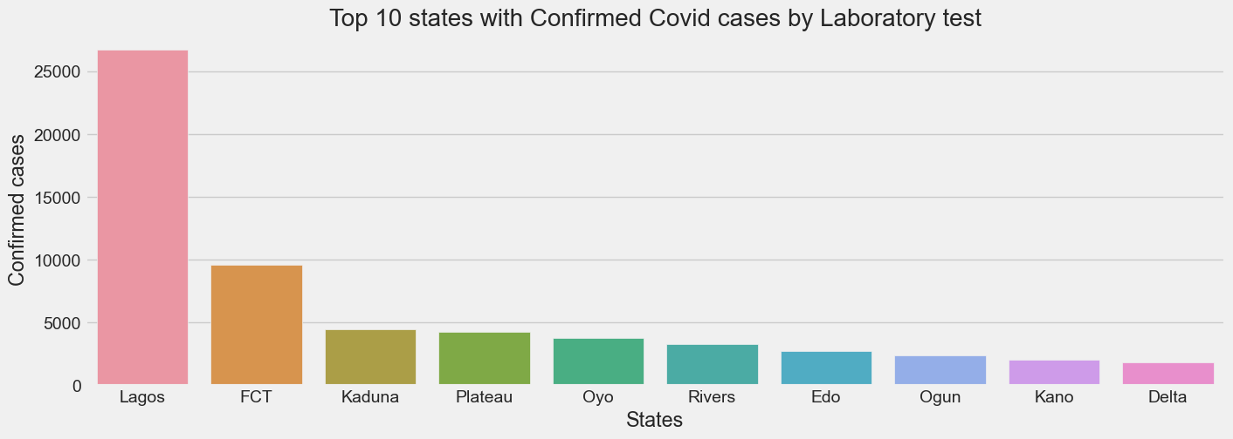

Slide 21
From the above result,
Lagos State recorded highest number of confirmed cases with over 25000 while Kano, Delta and Ogun recorded least with less than 3000 patients.

Slide 22
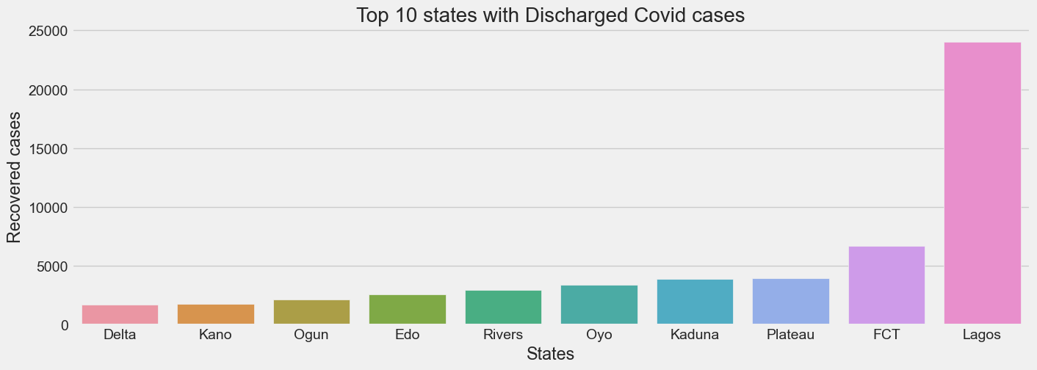

Slide 23
From the above result,
Lagos State recorded highest number of discharged patients with over 20000 while Delta, Kano and Ogun recorded the least with less than 3000 patients.

Slide 24
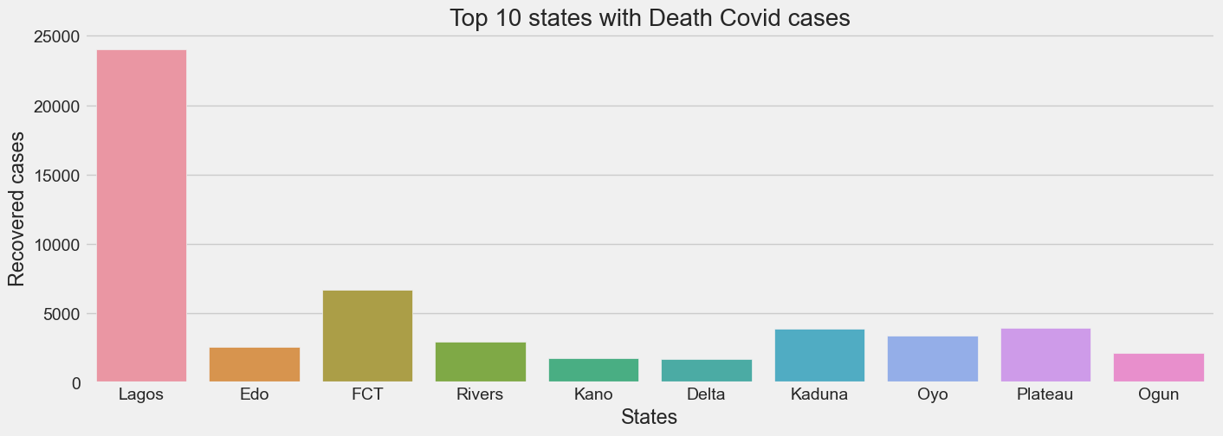

Slide 25
From the bar chart result above shows that:
Lagos has the highest number of discharged patients with close to 25000 while the Delta and Kano recorded the least discharged patients with less than 3000.
Abuja is the second highest number of discharged patients with more than 5000 but less than 10000.

Slide 26
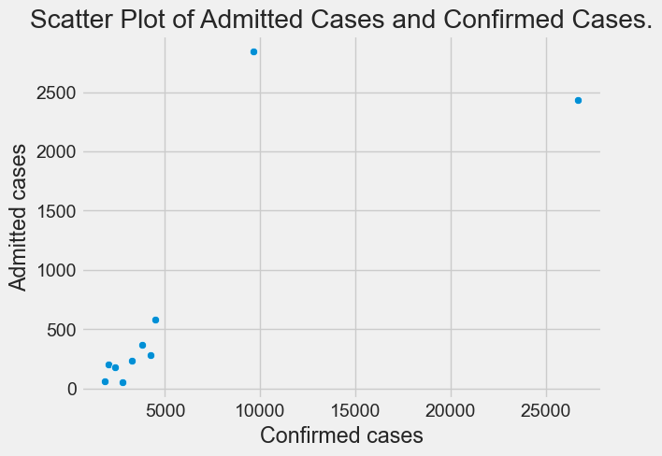

Slide 27
From the result above, it can be concluded that:
The number of admitted cases raise to over 2500 while Number of Confirmed Cases raise to over 25,000.

Slide 28
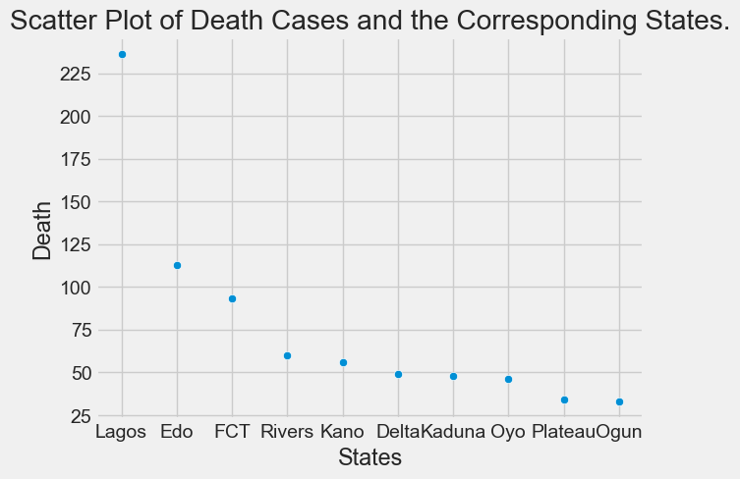

Slide 29
From the graph above result, it is shown that Lagos highest number of death record of more 225 follow by Edo with more than 100 but less than 125 while both Plateau and Ogun recorded less record of death below 50.

Slide 30
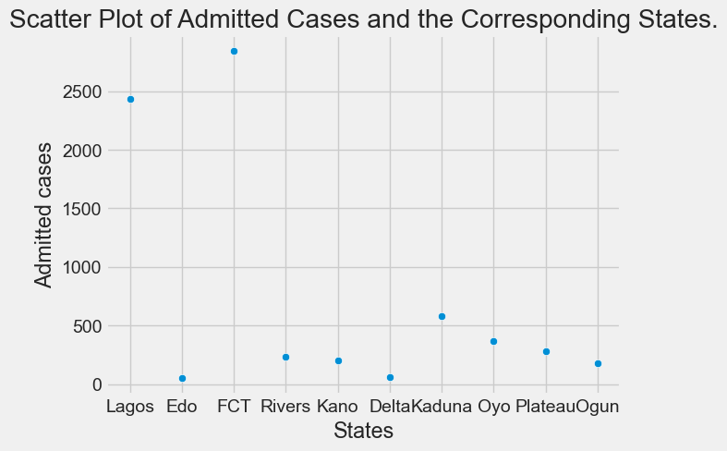

Slide 31
The Scatter graph above shows that FCT recorded the highest number of admission case of more than 2500 patients while Edo and Delta had below 250 patients recorded

Slide 32
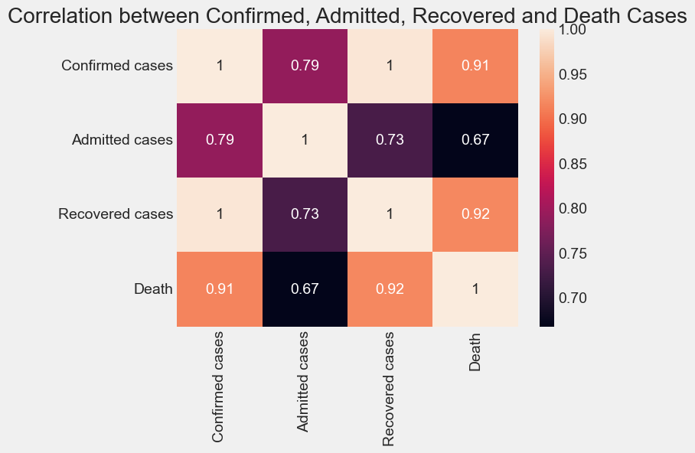

Slide 33
From the above result,
There is a high correlation coefficient between:
Death and Confirmed cases, correlation coefficient is 0.91
Recovered cases and Confirmed cases, correlation coefficient is 1
Recovered cases and Death cases, correlation coefficient is 0.92
Admitted cases and Confirmed cases, correlation coefficient is 0.79
Confirmed cases to Confirmed cases, correlation coefficient is 1
Death cases to Death cases, correlation coefficient is 1
Recovered cases to Recovered cases, correlation coefficient is 1
Admitted cases and Admitted cases, correlation coefficient is 1
Low correlation coefficient between Admitted cases and Death cases, correlation coefficient is 0.67

Slide 34
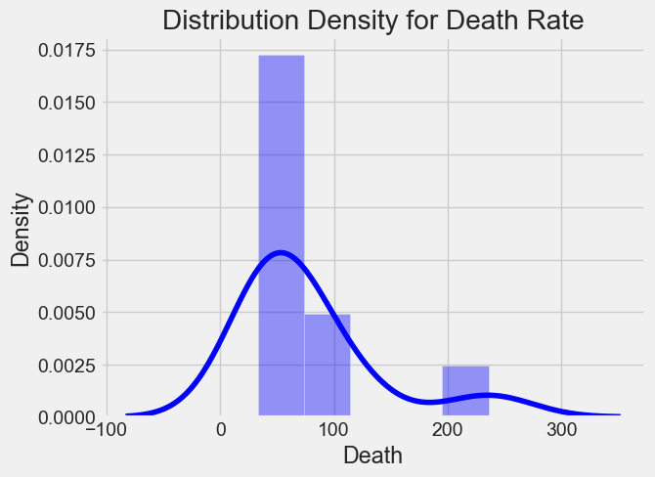

Slide 35
From the graph above,
Death Rate recorded mostly between 0 to 100.

Slide 36
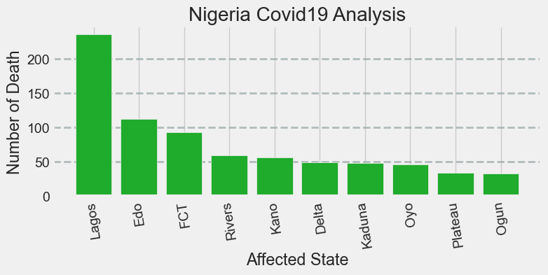

Slide 37
The bar chart above shows that Lagos State has the highest death rate while Ogun and Plateau States recorded the least death rate in Nigeria.

Slide 38
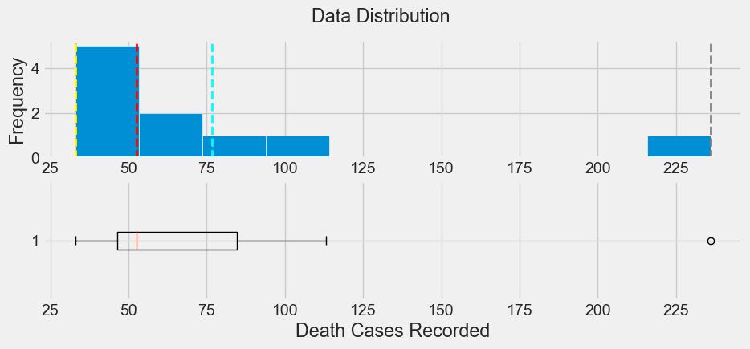

Slide 39
Comments:
The yellow dash vertical line signifies mode(most occurrence) rate of death.
The dashed vertical red line signifies median(middle) rate of death.
The dashed vertical cyan line signifies mean rate of death.
The dashed vertical red line signifies median(middle) rate of death.
The dashed vertical purple line signifies least rate of death.
The dashed vertical gray line signifies highest rate of death.

Slide 40
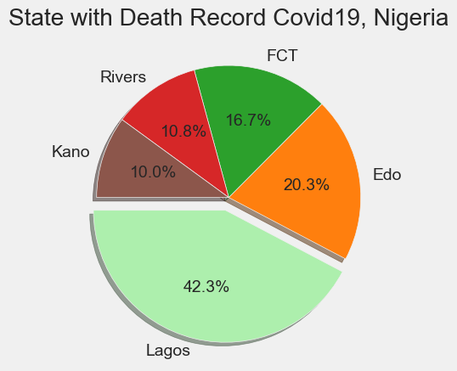

Slide 41
Comment:
Lagos recorded the highest death of 42.3% follow by Edo with 20.3% while Kano has the least record of 10%.
Therefore it is unsafe to live in Lagos.

Slide 42
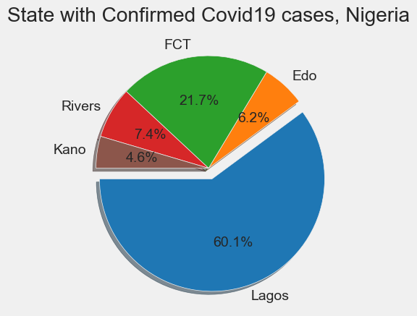

Slide 43
Base on the Pie Chart shown above
Lagos has the highest confirmed case record of 60.1% follow by FCT with 21.7% while Kano has the least confirmed case record.
Conclusion:
Covid19 virus tends to spread more in Lagos than any other state in Nigeria
It is more safe to live in Kano than in Lagos.

Slide 44
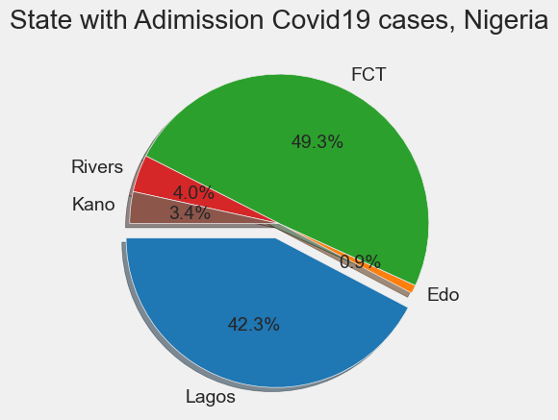

Slide 45
Comment:
Abuja has the highest number of admitted case record of 49.3% follow by Lagos with 42.3%% while Edo has the minimum number of admitted case record of 0.9%.

Slide 46
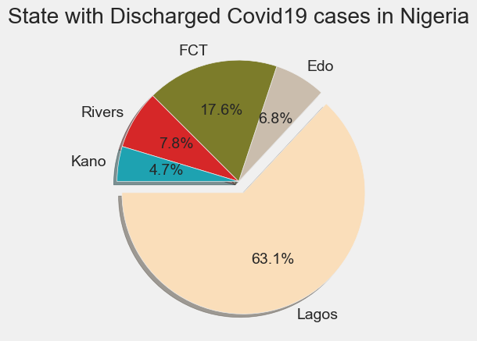

Slide 47
The above pie chart shows that:
Lagos is the state with the highest record of discharged with 63.1% follow by FCT with 17.6% while Kano has the least record of discharged record.

Slide 48
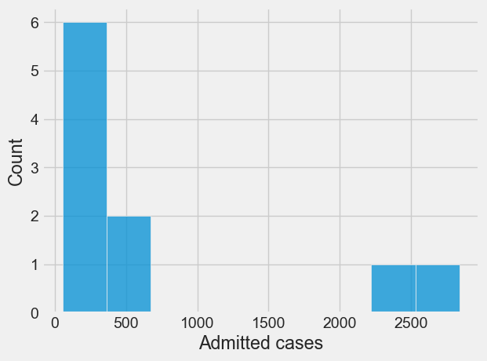

Slide 49
From the graph above, it can be concluded that:
Below 500 Patients were admitted and affected by covid-19 virus mostly.
No admitted record cases for patients between 1000 and 2000.

Slide 50
Collection of John Hopkins data
Global Daily Confirmed Cases - Click https://github.com/CSSEGISandData/COVID-19/blob/master/csse_covid_19_data/csse_covid_19_time_series/time_series_covid19_confirmed_global.csv
Global Daily Recovered Cases - Click https://github.com/CSSEGISandData/COVID-19/blob/master/csse_covid_19_data/csse_covid_19_time_series/time_series_covid19_recovered_global.csv
Global Daily Death Cases - Click Here https://github.com/CSSEGISandData/COVID-19/blob/master/csse_covid_19_data/csse_covid_19_time_series/time_series_covid19_deaths_global.csv

Slide 51
External Data
gdp_df = pd.read_csv('RealGDP.csv')
gdp_df
Year | Q1 | Q2 | Q3 | Q4
0 | 2014 | 15438679.50 | 16084622.31 | 17479127.58 | 18150356.45
1 | 2015 | 16050601.38 | 16463341.91 | 17976234.59 | 18533752.07
2 | 2016 | 15943714.54 | 16218542.41 | 17555441.69 | 18213537.29
3 | 2017 | 15797965.83 | 16334719.27 | 17760228.17 | 18598067.07
4 | 2018 | 16096654.19 | 16580508.07 | 18081342.10 | 19041437.59
5 | 2019 | 16434552.65 | 16931434.89 | 18494114.17 | 19530000.00
6 | 2020 | 16740000.00 | 15890000.00 | 17820000.00 | 0.00

Slide 52
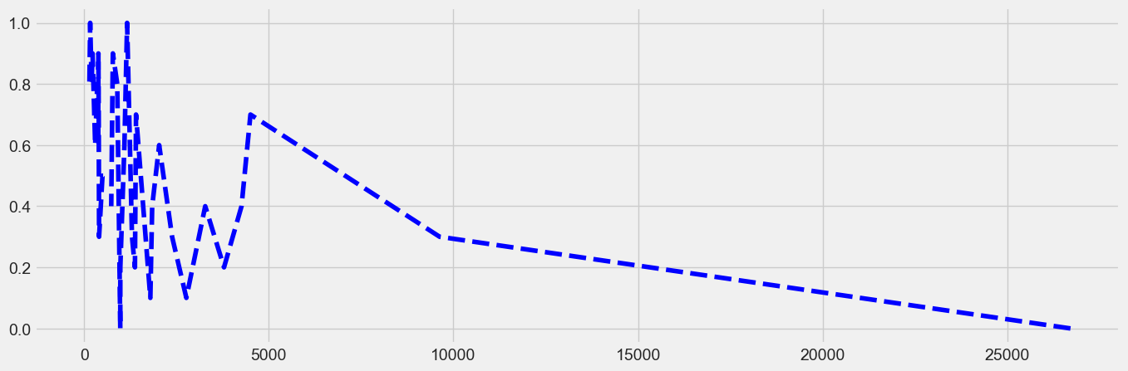

Slide 53
The result above shows that:
Less dense area has the highest confirmed cases.

Slide 54
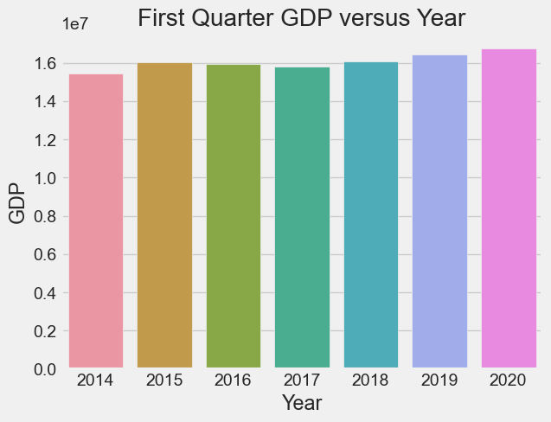

Slide 55
From the above graph,
It can be concluded that year 2020 recorded the highest GDP with more than 16 million while year 2014 recorded the least GDP with less than 16 million.

Slide 56
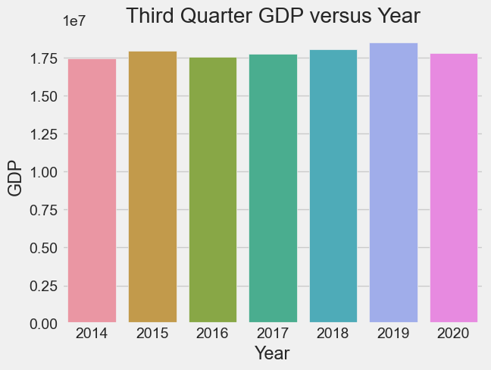

Slide 57
The graph above shows that:
In the third quarter of the year, year 2019 recorded the highest GDP close to 20 million while year 2014 and 2016 recorded the least GDP of 17.5 million.

Slide 58
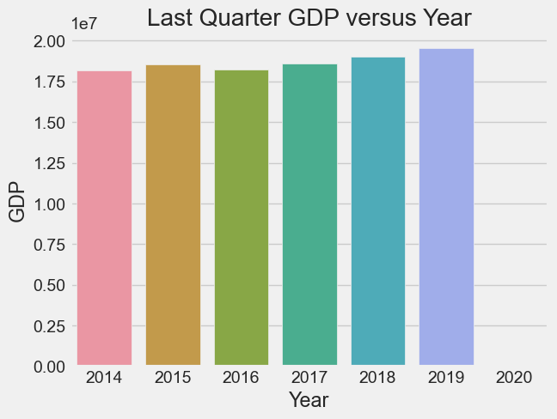

Slide 59
The graph shows that, in the last quarter of the year,
No GDP was recorded in the 2020,2019 was the year recorded the highest GDP approximately 20million while 2014 and 2016 recorded the least GDP.

Slide 60
Conclusion
It is no longer a news that COVID-19 pandemic has left no part of the world untouched. The virus emerged from Wuhan, China, and spread to all other country for example Nigeria. Base on the analysis carried out so far, COVID-19 pandemic has an enormous effect on Nigeria health, education, transportation, finance, telecommunication just to mention few. It is high time for leadership, citizens and state institutions to come together for solutions to prevent the deadly virus from spreading.

